Slide 1

ECE 220 Computer Systems & Programming
Lecture 21 – Trees: traversal and search
Notes:
ECE Main Slide

Slide 2
Tree Data Structure
Array, linked list, stack, queue – linear data structures
Tree: A data structure that captures hierarchical nature of relations between data elements using a set of linked nodes. Nodes are connected by edges. It’s a nonlinear data structure.
Tree Terminology:
root, internal node, external node (leaf), inner nodes
parent, child, sibling, height, depth
The depth of a node is the number of edges
from the node to the tree's root node. A root node will have a depth of 0.
The height of a node is the number of
edges on the longest path from the node to a leaf. A leaf node will have a height of 0.
2

Slide 3
Binary Tree
Each node has at most 2 children – left child and right child
What is the height of the tree?
What is the depth of node E?
What is the height of node E?
Which nodes are leaves?
3

Slide 4
Common Operations on Tree:
Locate an item
Add a new item at a particular place
Delete an item
Remove a section of a tree (pruning)
Add a new section to a tree (grafting)

Slide 5
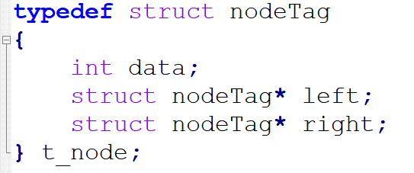
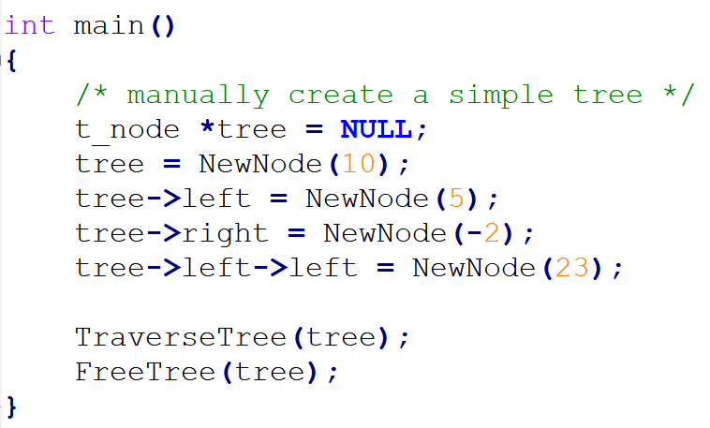
Manually Creating a simple tree:

Slide 6
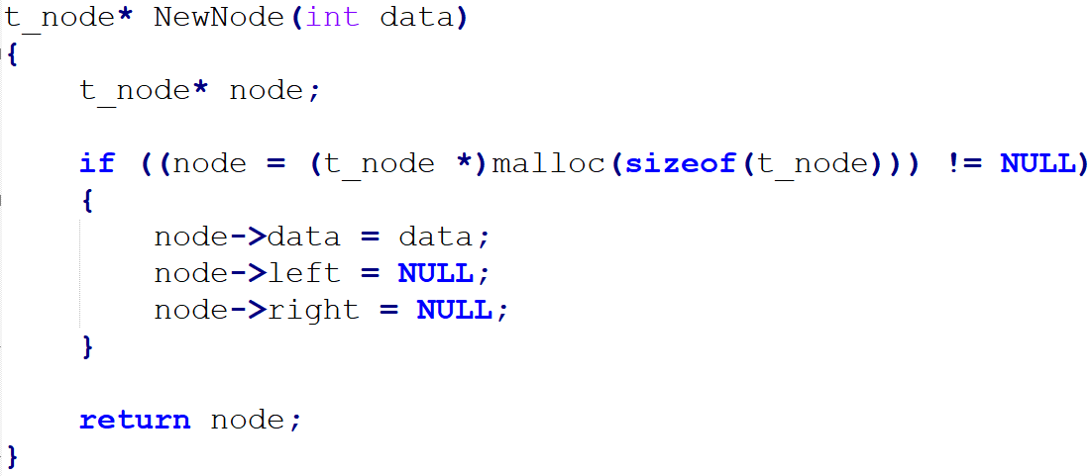
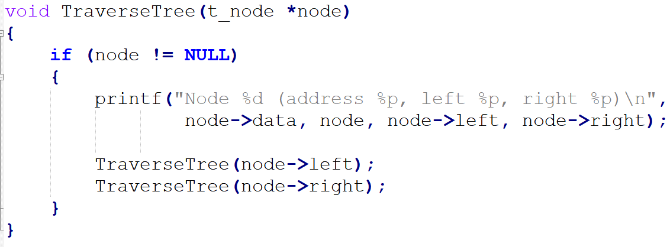

Slide 7
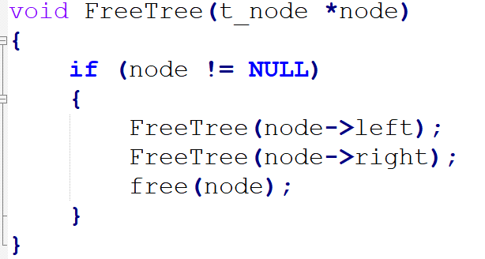

Slide 8
Tree Traversal – BFS & DFS
Breadth-First Search (level-order)
Depth-First Search
Pre-order: root, left, right
In-order: left, root, right
Post-order: left, right, root
4
Notes:
void bfs_bintree (btree_t *head) { queue_t *q; btree_t *temp; q = queue_allocate (); queue_insert (q, head); while (!queue_is_empty (q)) { temp = queue_remove (q); if (temp->left) queue_insert (temp->left); if (temp->right) queue_insert (temp->right); } queue_free (q); return; }

Slide 9
Binary Search Tree
Data of nodes on the left subtree is smaller than the data of parent node
Data of nodes on the right subtree is larger than the data of parent node
Both left and right subtrees must also be BST
Data in each node is unique
What is the sequence of access for
1. pre-order traversal?
2. in-order traversal?
3. post-order traversal?
http://visualgo.net/bst.html
5

Slide 10
Search for a Node in BST
typedef struct treeNode node;
struct treeNode{
int data;
node *left;
node *right;
};
node *search(node* root, int data){/*assume data is in BST*/
/*base case*/
/*recursive case*/
}
6

Slide 11
node *find_min(node *root){ /*find the smallest node in BST*/
}
node *find_max(node *root){ /*find the largest node in BST*/
}
7

Slide 12
Traverse a BST
void preorder(node *root){
}
void inorder(node *root){
}
void postorder(node *root){
}
8

